Slide 1
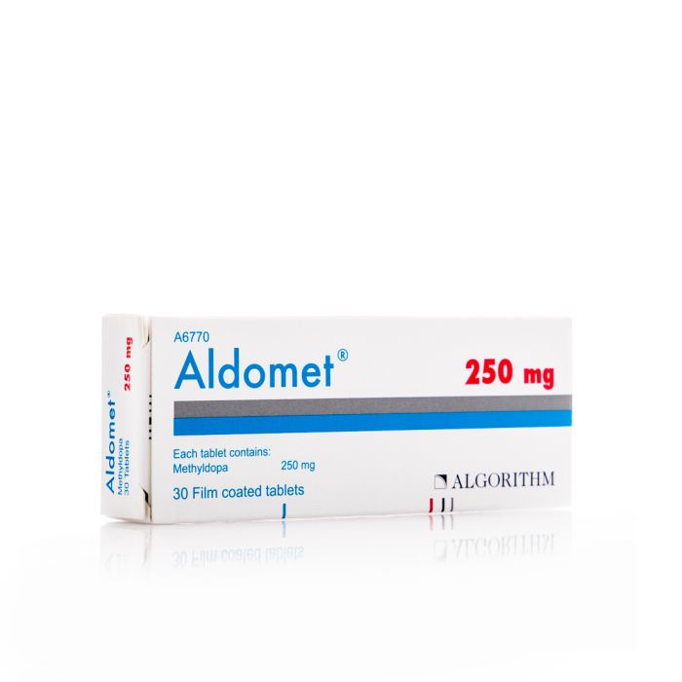
Dumit 250 mg
Tablets 30 pills
13.15 SAR. Q

Slide 2
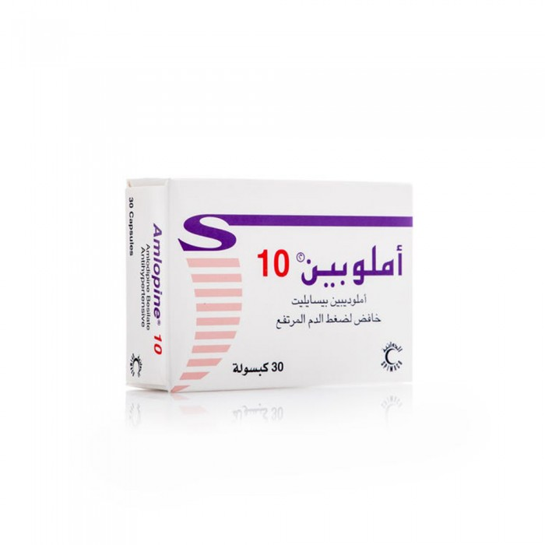
Amlobin 10 mg
30 capsules
SAR 51.05. Q

Slide 3
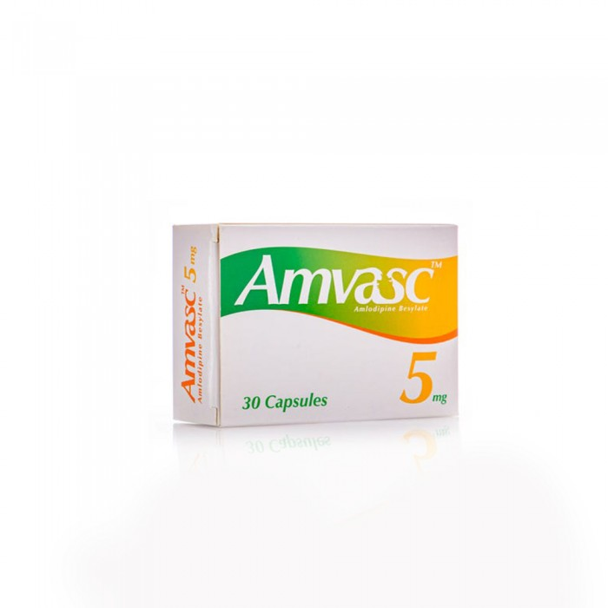
Mvask 5 mg
30 capsules
48.00 SAR. Q

Slide 4
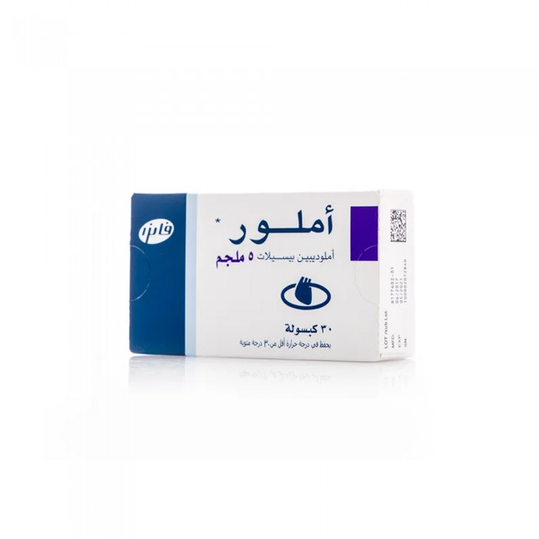
AMLOR 5 mg
30 capsules
63.85 SAR. Q

